Slide 1
Section 11.7
Plane Curves and Parametric Equations
Copyright © 2012 Pearson Education, Inc. Publishing as Prentice Hall.

Slide 2
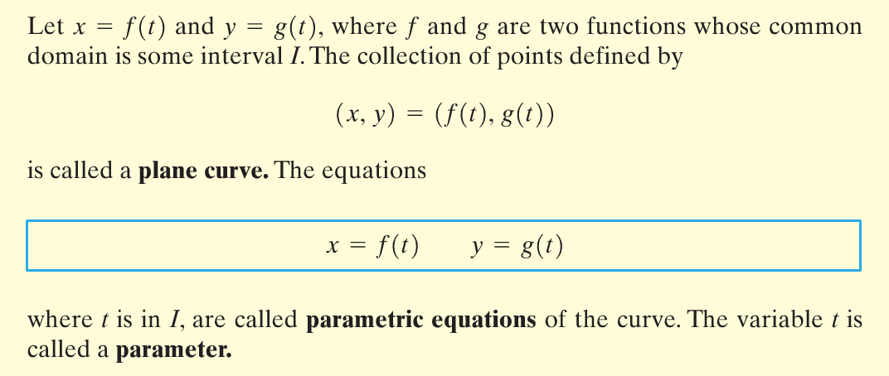
Copyright © 2012 Pearson Education, Inc. Publishing as Prentice Hall.

Slide 3

Copyright © 2012 Pearson Education, Inc. Publishing as Prentice Hall.

Slide 4

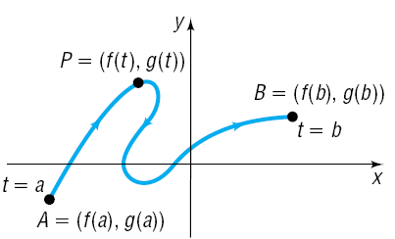
Copyright © 2012 Pearson Education, Inc. Publishing as Prentice Hall.

Slide 5

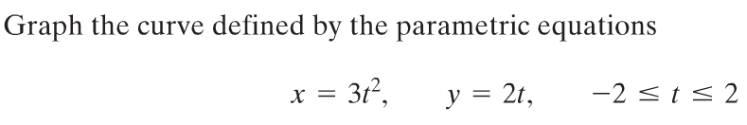
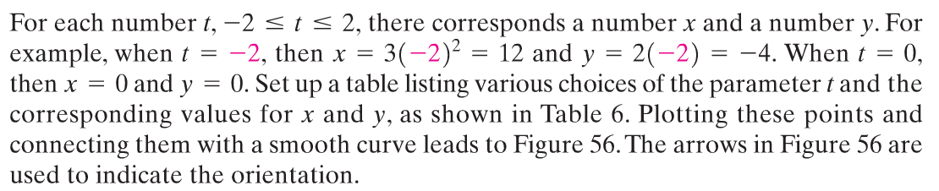
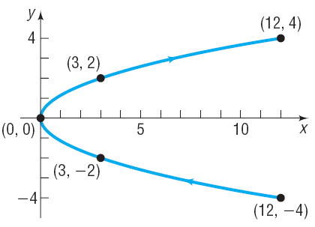
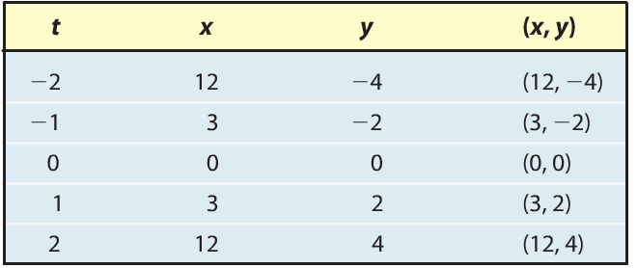
Copyright © 2012 Pearson Education, Inc. Publishing as Prentice Hall.

Slide 6
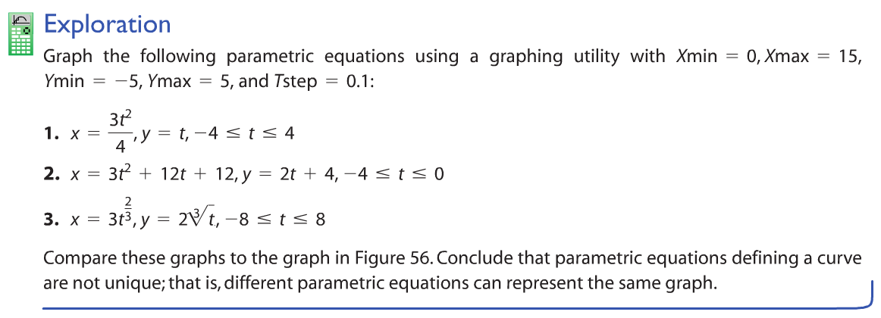
Copyright © 2012 Pearson Education, Inc. Publishing as Prentice Hall.

Slide 7

Copyright © 2012 Pearson Education, Inc. Publishing as Prentice Hall.

Slide 8
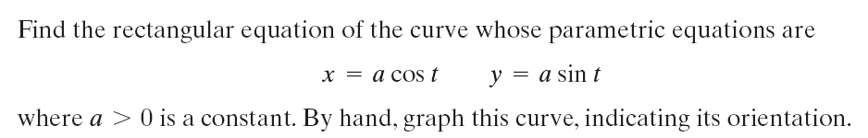

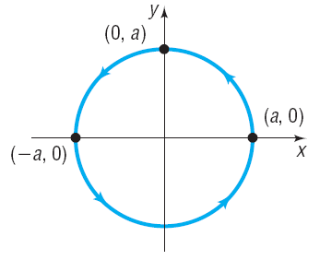
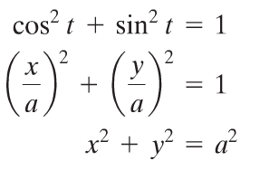
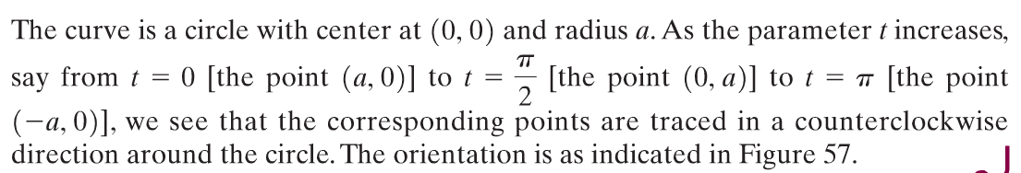
Copyright © 2012 Pearson Education, Inc. Publishing as Prentice Hall.

Slide 9
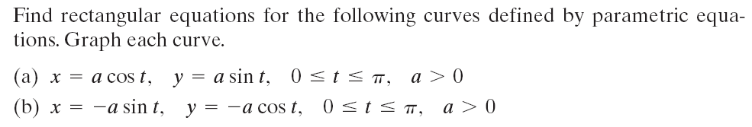
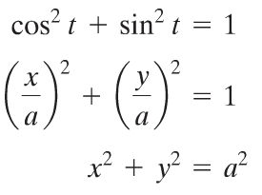
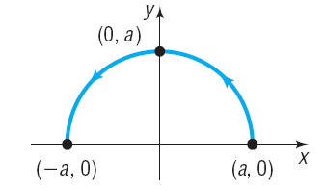

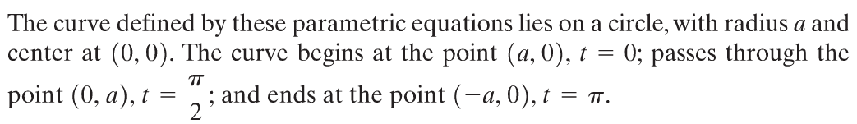
Copyright © 2012 Pearson Education, Inc. Publishing as Prentice Hall.

Slide 10
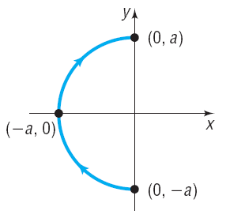
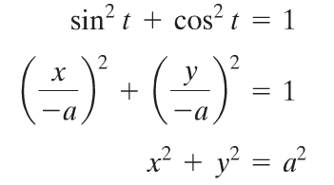

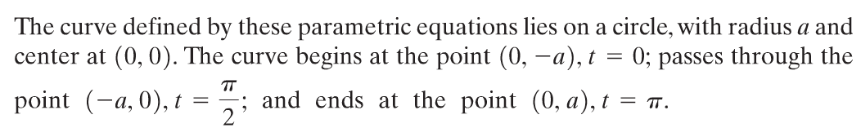
Copyright © 2012 Pearson Education, Inc. Publishing as Prentice Hall.

Slide 11
Copyright © 2012 Pearson Education, Inc. Publishing as Prentice Hall.

Slide 12

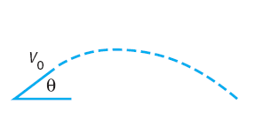

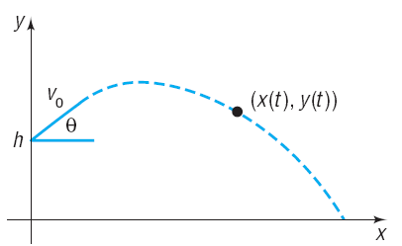
Copyright © 2012 Pearson Education, Inc. Publishing as Prentice Hall.

Slide 13

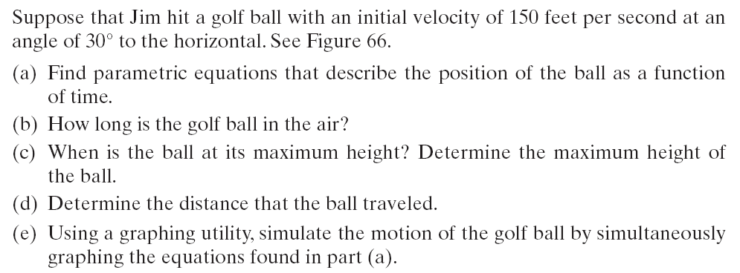
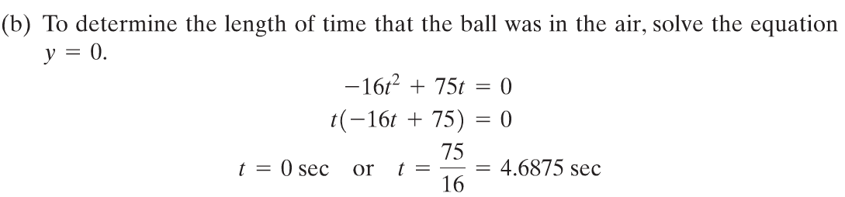
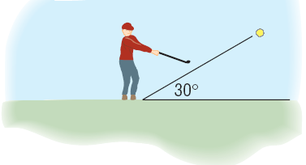


Copyright © 2012 Pearson Education, Inc. Publishing as Prentice Hall.

Slide 14
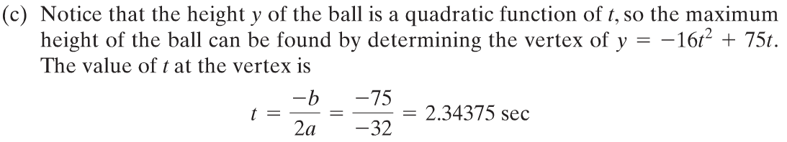
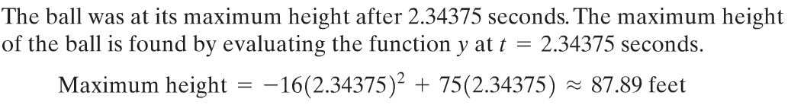
Copyright © 2012 Pearson Education, Inc. Publishing as Prentice Hall.

Slide 15
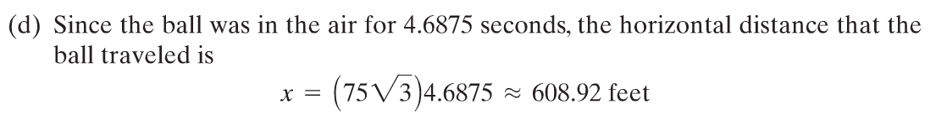
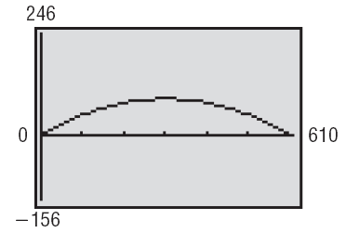
Copyright © 2012 Pearson Education, Inc. Publishing as Prentice Hall.

Slide 16


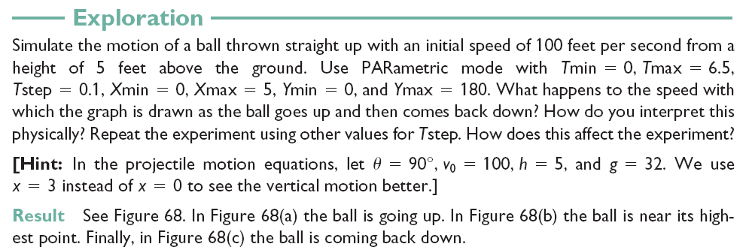
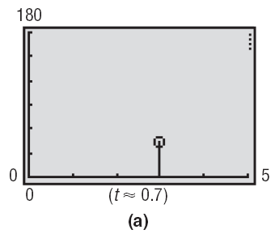
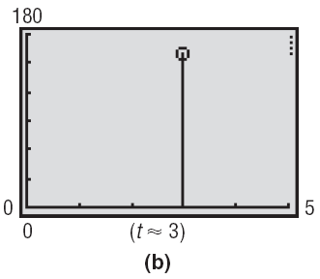
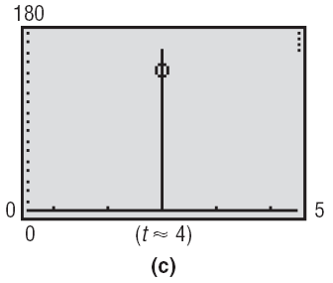
Copyright © 2012 Pearson Education, Inc. Publishing as Prentice Hall.

Slide 17

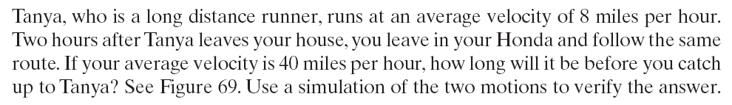
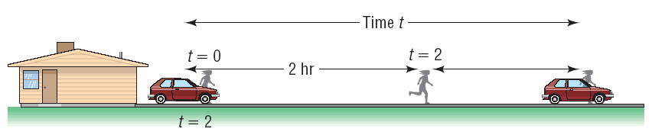

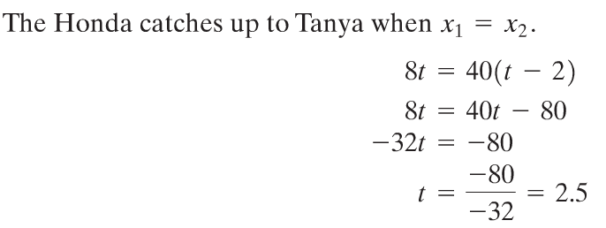
Copyright © 2012 Pearson Education, Inc. Publishing as Prentice Hall.

Slide 18
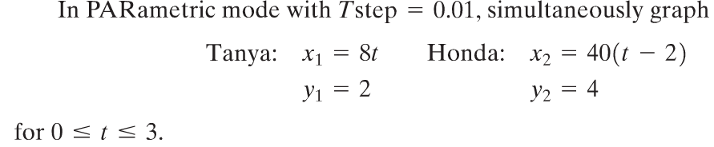
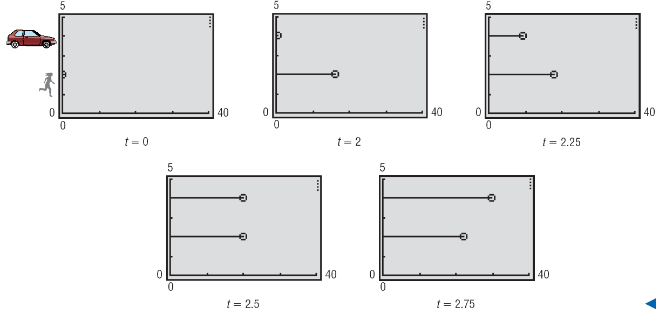
Copyright © 2012 Pearson Education, Inc. Publishing as Prentice Hall.

Slide 19

Copyright © 2012 Pearson Education, Inc. Publishing as Prentice Hall.

Slide 20

Copyright © 2012 Pearson Education, Inc. Publishing as Prentice Hall.

Slide 21
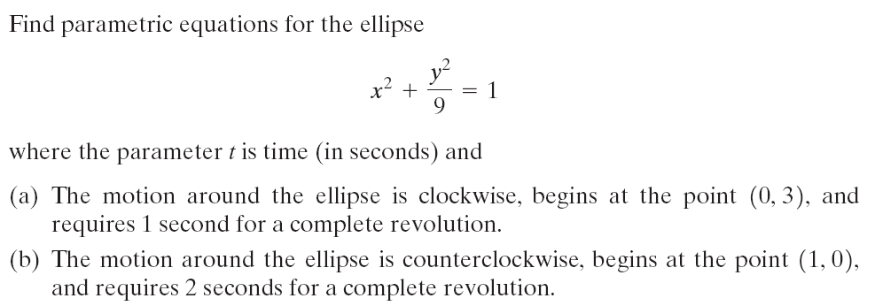
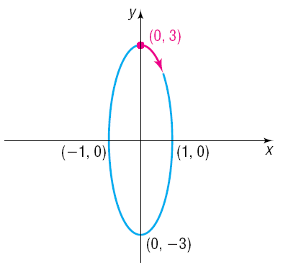
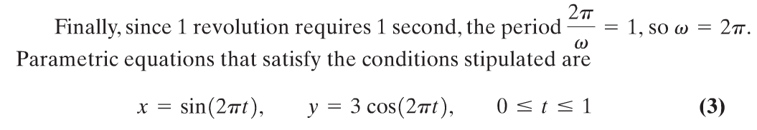
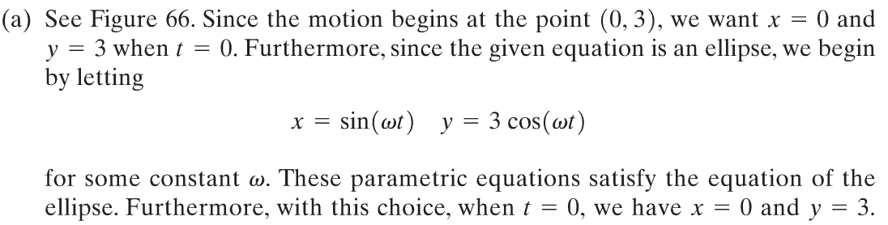
The motion around the ellipse is clockwise, begins at the point (0,3), and requires 1 second for a complete revolution.
Copyright © 2012 Pearson Education, Inc. Publishing as Prentice Hall.

Slide 22
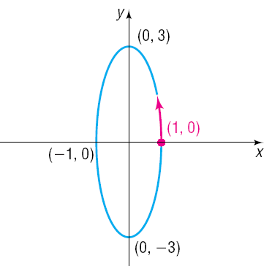
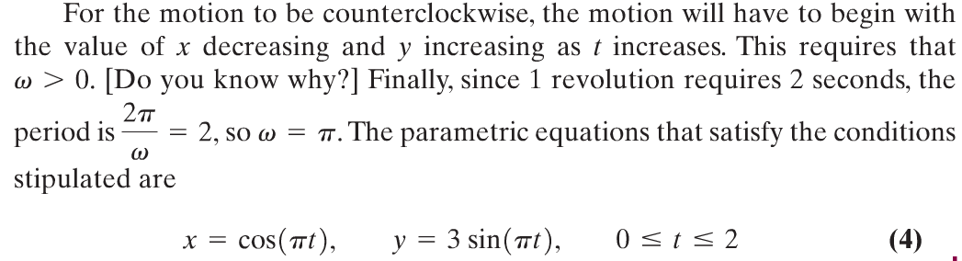
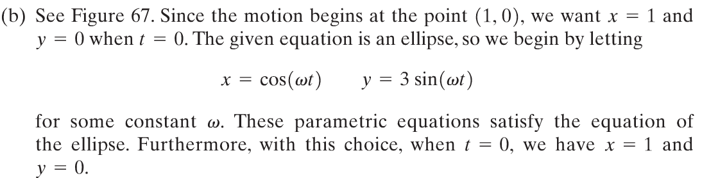
(b) The motion around the ellipse is counterclockwise, begins at the point (1, 0), and requires 2 seconds for a complete revolution.
Copyright © 2012 Pearson Education, Inc. Publishing as Prentice Hall.

Slide 23

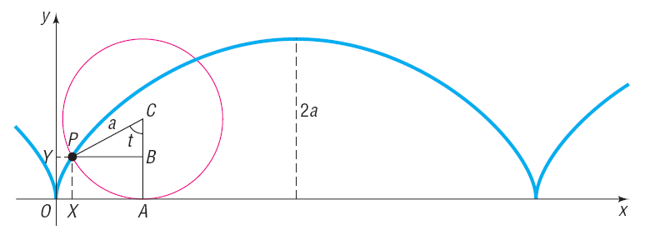


Copyright © 2012 Pearson Education, Inc. Publishing as Prentice Hall.

Slide 24

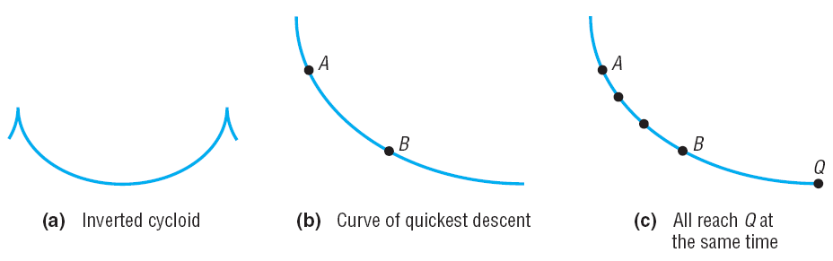
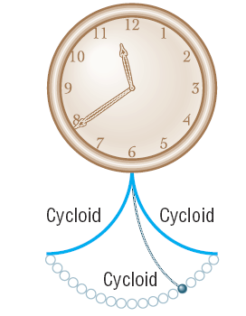
Copyright © 2012 Pearson Education, Inc. Publishing as Prentice Hall.

